Slide 1
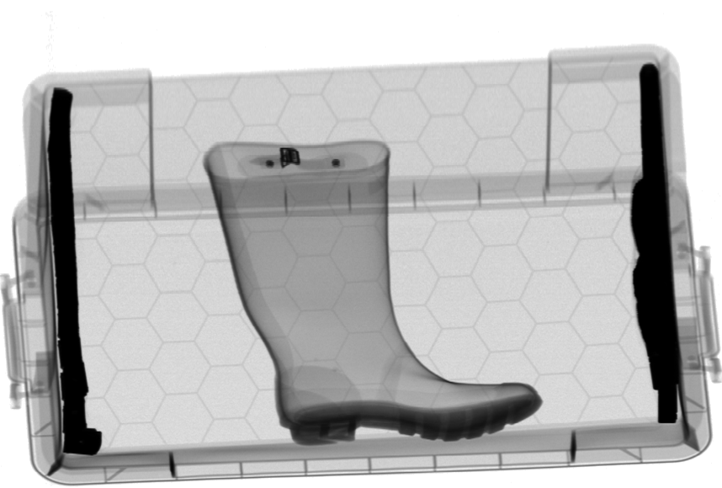
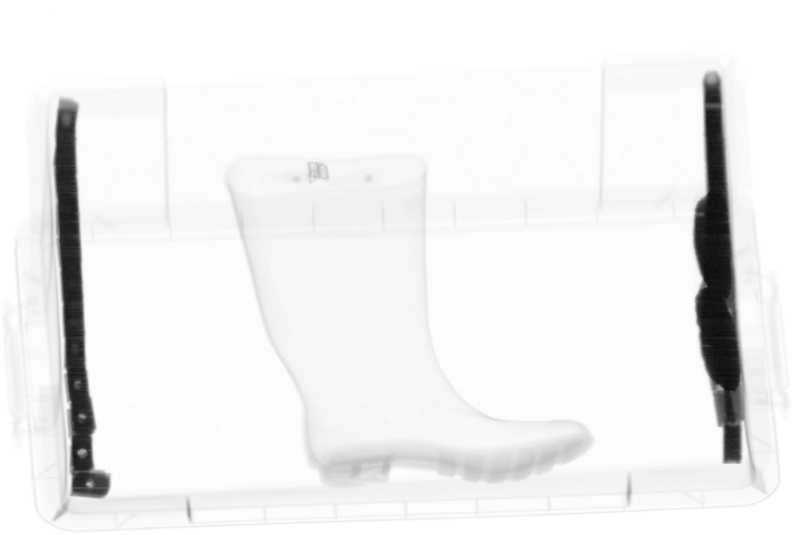
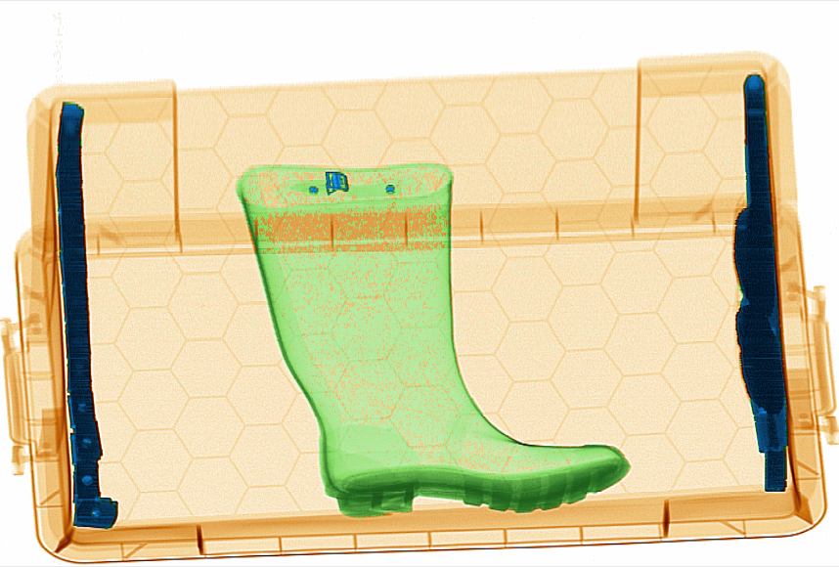
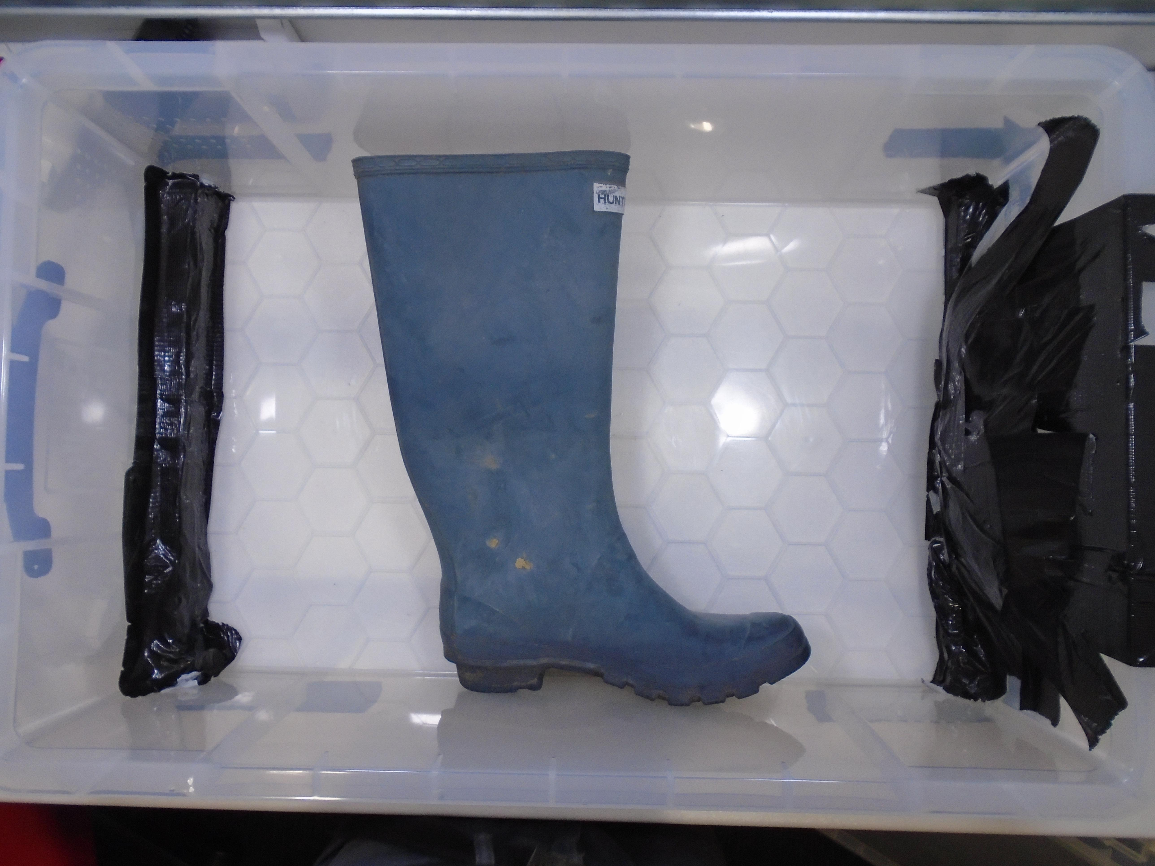
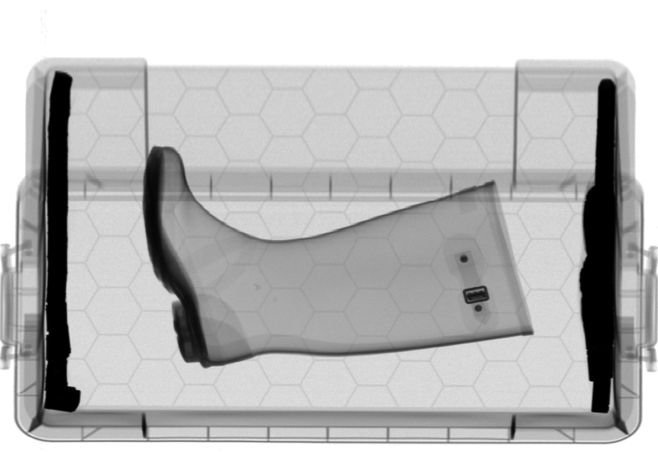
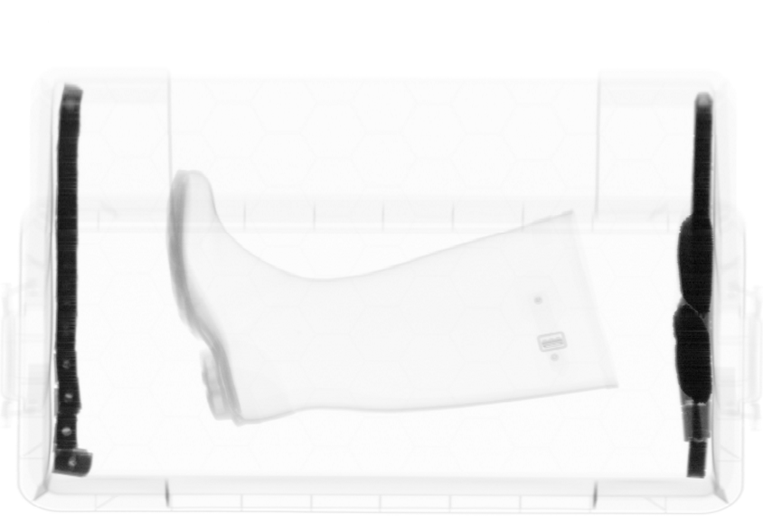
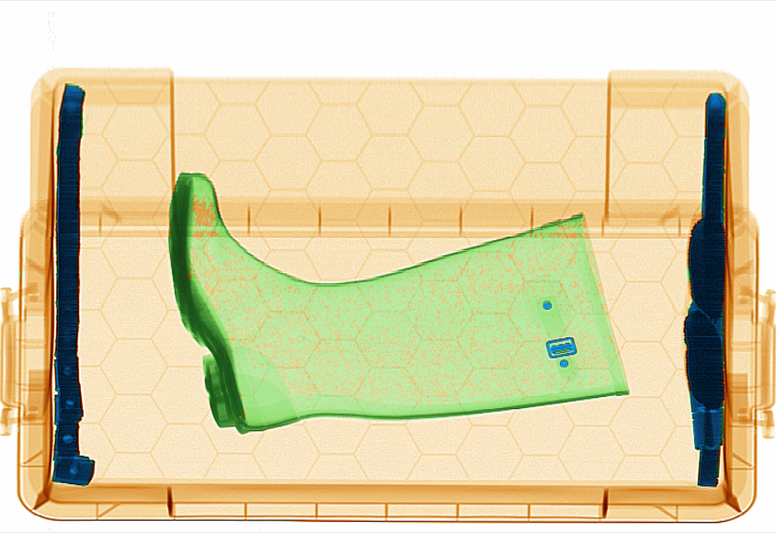
视角1
视角1
X光探测器
物体
X
光
管
B
低能级
高能级
融合
伪彩色图像
视角2
视角2
X
光
管
A
C
低能级
高能级
融合
伪彩色图像

Slide 2
YOLOv1
Joseph Redmon
YOLOv3
Joseph Redmon
YOLOX
旷视科技
YOLOv8
Ultralytics
2016
2017
2018
2020
2021
2022
2023
2024
YOLOv2
Joseph Redmon
YOLOv4
Alexey Bochkovskiy
YOLOv5
Ultralytics
YOLOv6
美团视觉
YOLOv7
Alexey Bochkovskiy
YOLOv9
Chien-Yao Wang
YOLOv10
Ao Wang
YOLO11
Ultralytics

Slide 3
YOLOv1
Joseph Redmon
YOLOv3
Joseph Redmon
YOLOX
旷视科技
YOLOv8
Ultralytics
2016
2017
2018
2020
2021
2022
2023
2024
YOLOv2
Joseph Redmon
YOLOv4
Alexey Bochkovskiy
YOLOv5
Ultralytics
YOLOv6
美团视觉
YOLOv7
Alexey Bochkovskiy
YOLOv9
Chien-Yao Wang
YOLOv10
Ao Wang
YOLO11
Ultralytics

Slide 4
YOLOv1
Joseph Redmon
YOLOv3
Joseph Redmon
YOLOX
旷视科技
YOLOv8
Ultralytics
2016
2017
2018
2020
2021
2022
2023
2024
YOLOv2
Joseph Redmon
YOLOv4
Alexey Bochkovskiy
YOLOv5
Ultralytics
YOLOv6
美团视觉
YOLOv7
Alexey Bochkovskiy
YOLOv9
Chien-Yao Wang
YOLOv10
Ao Wang
YOLO11
Ultralytics

Slide 5
YOLOv1
Joseph Redmon
YOLOv3
Joseph Redmon
YOLOX
旷视科技
YOLOv8
Ultralytics
2016
2017
2018
2020
2021
2022
2023
2024
YOLOv2
Joseph Redmon
YOLOv4
Alexey Bochkovskiy
YOLOv5
Ultralytics
YOLOv6
美团视觉
YOLOv7
Alexey Bochkovskiy
YOLOv9
Chien-Yao Wang
YOLOv10
Ao Wang
YOLO11
Ultralytics

Slide 6


Slide 7
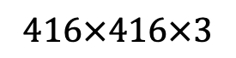
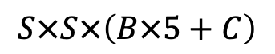
输入
Googlenet
[51]
输出
Conv
…
FC
…
Resheap
$$416×416×3$$
$$S×S×\left(B×5+C\right)$$

Slide 8

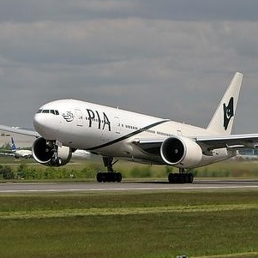

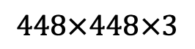
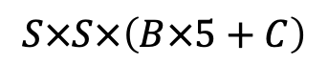
输入
Googlenet
[51]
输出
Conv
…
FC
…
Resheap
$$448×448×3$$
$$S×S×\left(B×5+C\right)$$

Slide 9
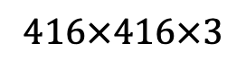

输入
$$416×416×3$$
CBL
=
Conv
Bn
Leaky Relu
Darknet-19
[53]
CBL
CBL
Concat
CBL
Conv
CBL
Rcorg
$$S×S×\left(B×5+C\right)$$
特征提取
特征融合
检测头

Slide 10
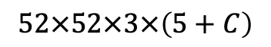
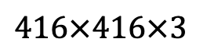
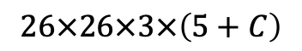
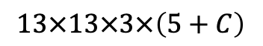
输入
Res
=
CBL
CBL
Add
$$416×416×3$$
CBL
$$13×13×3×\left(5+C\right)$$
Res1
Res2
CBL*5
CBL
Conv
Res8
Concat
UpSample
CBL
$$26×26×3×\left(5+C\right)$$
CBL*5
CBL
Conv
Res8
Concat
UpSample
CBL
$$52×52×3×\left(5+C\right)$$
Res4
CBL*5
CBL
Conv
特征提取
特征融合
检测头

Slide 11
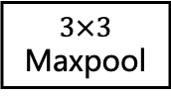
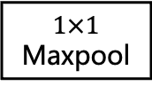
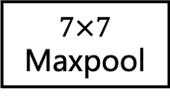
$$1×1$$
Maxpool
SPP
=
$$3×3$$
Maxpool
Concat
...
$$7×7$$
Maxpool

Slide 12
Conv
Sigmoid
Reg_Loss
CBL*2
YOLOX
Decoupled Head
=
CBL
Conv
Sigmoid
Obj_Loss
Concat
CBL*2
Conv
Sigmoid
Cls_Loss

Slide 13
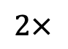
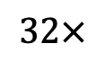
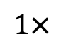
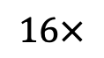
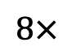
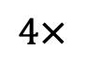
$$32×$$
引导头
$$16×$$
引导头
$$8×$$
引导头
$$4×$$
辅助头
$$2×$$
辅助头
$$1×$$
辅助头

